Slide 1
E-Wallets and Payments
NIVED YOGESHKUMAR SOLANKI 1NH17CS093

Slide 2
COURSE OBJECTIVES:
Students should be able to write JAVA application programs with proper program structuring using OOPS principles.
Students should be able to implement error handling techniques using exception handling.
Students should be able to build a swing application or any other advanced GUI for frontend and apply JDBC concepts to access database.
Students should be able to use various I/O manipulation operations through I/O streams.
Students should be able to use analyse and optimise the solutions.

Slide 3
ABSTRACT:
E-Wallets and Payments is a project that aims to develop an online payment method for customers with the goal of setting all card details in one place so that it is very easy to make payments online from an extensive number of options available on the application. With the help of this, you can carry out any online payment from your home.
The system proposed provides information about various areas where we need online payments to make our purchase. Here is no compelling reason to go to the various other methods of paying or shopping online.
To get to this online payment system, all the customers will need to have a phone number and password to log in and proceed with your payment. Upon successful login, the customers can make a wide range of transactions, can be dispatched using the online payment system. When the user enters the details, the user interface then passes the input to the control function which is implemented in Java.
The project is implemented using JAVA and MySQL, frontend manipulation is done using Eclipse and JDBC connection is inculcated to store data at the backend.

Slide 4
OBJECTIVES :
The main objective of this project is to inculcate a user friendly application for making Online payments even more simpler than ones existing today.
The system proposed provides information about the various payment methods and solutions to make an easy purchase ever after in the same way.
The user being the customers approach the various tabs available to know details about how to make a transaction and if a payment mode is available for the kind of transaction they want to make.
Our application stores every card detail added initially and also stores transaction information for future security.

Slide 5
PROBLEM DEFINITION:
The Project develops a portal for E-wallets and Payment, which allows the user to enter the login details. It is also used to manage details of Username, Password, 4 digit MTPN, name, age, address and phone number to sign up. Only users can be able to access it in order to enter the signing up details of the Payment application.
The maintenance of these details comes into the task of the administrator where he is responsible to maintain the details like Username, Password, 4-digit MTPN, name, age, address and phone number. All these things will be maintained by the system. The system has functions based on the Recharge, Pay bills, Book Travels, Money Transfer, Pay for Movies via Entertainment Tab, Order Food etc...

Slide 6
E-wallets and Payments should have good user interfaces with menus and toolbars. The main goal of this project is designing and developing an interactive online payment application. These details are routinely maintained depending on the numerous inputs and the changes made in the system database.
Transactions can be searched according to their used years or price and payment type which makes it easy to search for the customers. There’s no chance of data misuse or loss & it’s not time-consuming.
The whole project is developed in JAVA, different variables and strings have been used for the development of this project. It’s easy to operate and understand by the users.

Slide 7
POSSIBLE OUTCOMES:
To help in managing data related to buyers and sellers of any product with the payment.
To make business reports which can also be generated and viewed.
For addition of payments and its details
For viewing the transactions
For searching a transaction based on type and price and name of the payment.

Slide 8
DESIGN GOALS:
To develop a project to make a user friendly approach for it’s customers.
To manage details of Username, Password, 4 digit MTPN, name, age, address and phone number to sign up.
To provide a system which has functions based on the Recharge, Pay bills, Book Travels, Money Transfer, Pay for Movies via Entertainment Tab, Order Food etc.
To store transaction history and card details with trusted encryption.

Slide 9
FUNCTIONALITIES:
Application:
The application performs the following functionalities:
Log in security with phone number to sign up.
Secured Payments based on the Recharge, Pay bills, Book Travels, Money Transfer, Pay for Movies via Entertainment Tab, Order Food etc.

Slide 10
l
CUSTOMER:
The customer performs the following operations:
For viewing the transactions.
For searching a transaction based on type, price and name of the payment.
Data:
The consumer performs the following operations:
To register and login through the portal.
To store personal details and transaction history.

Slide 11
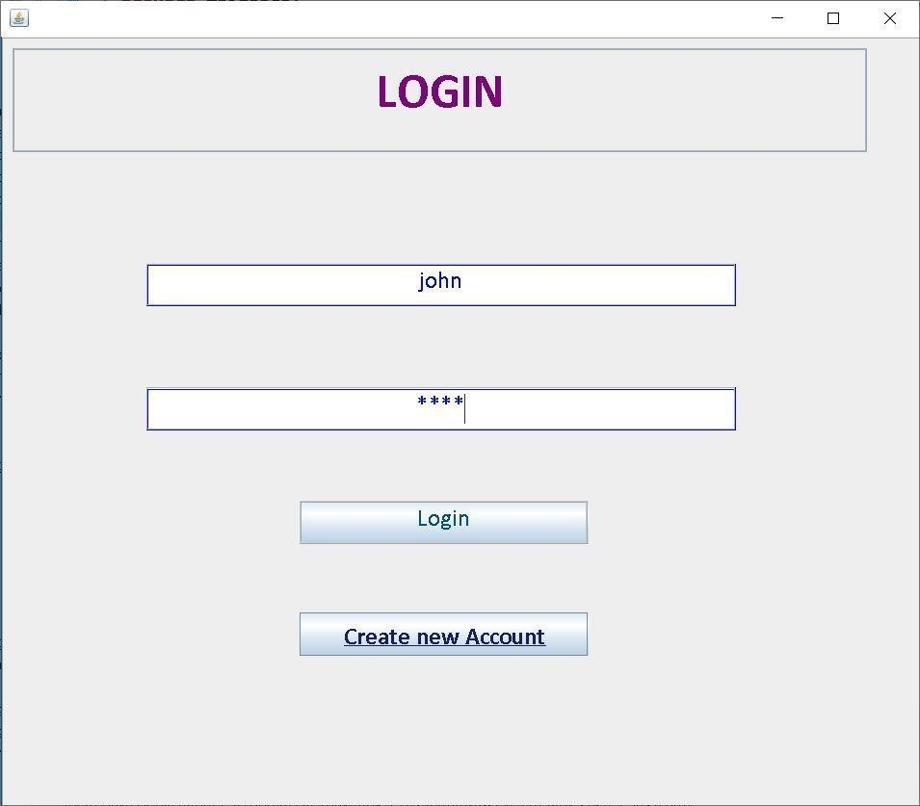
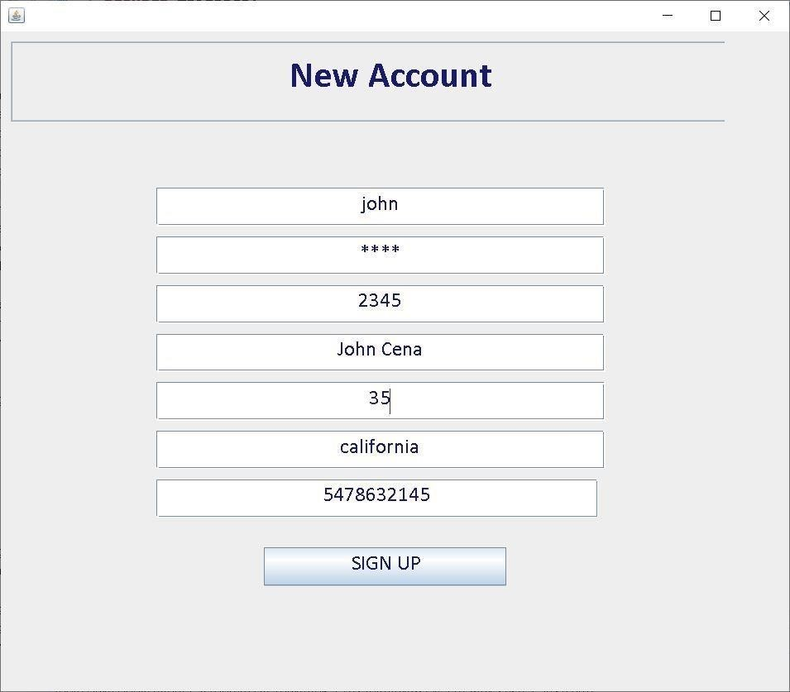
OUTPUT SNAPSHOTS:
Login Panel
Sign Up Form

Slide 12
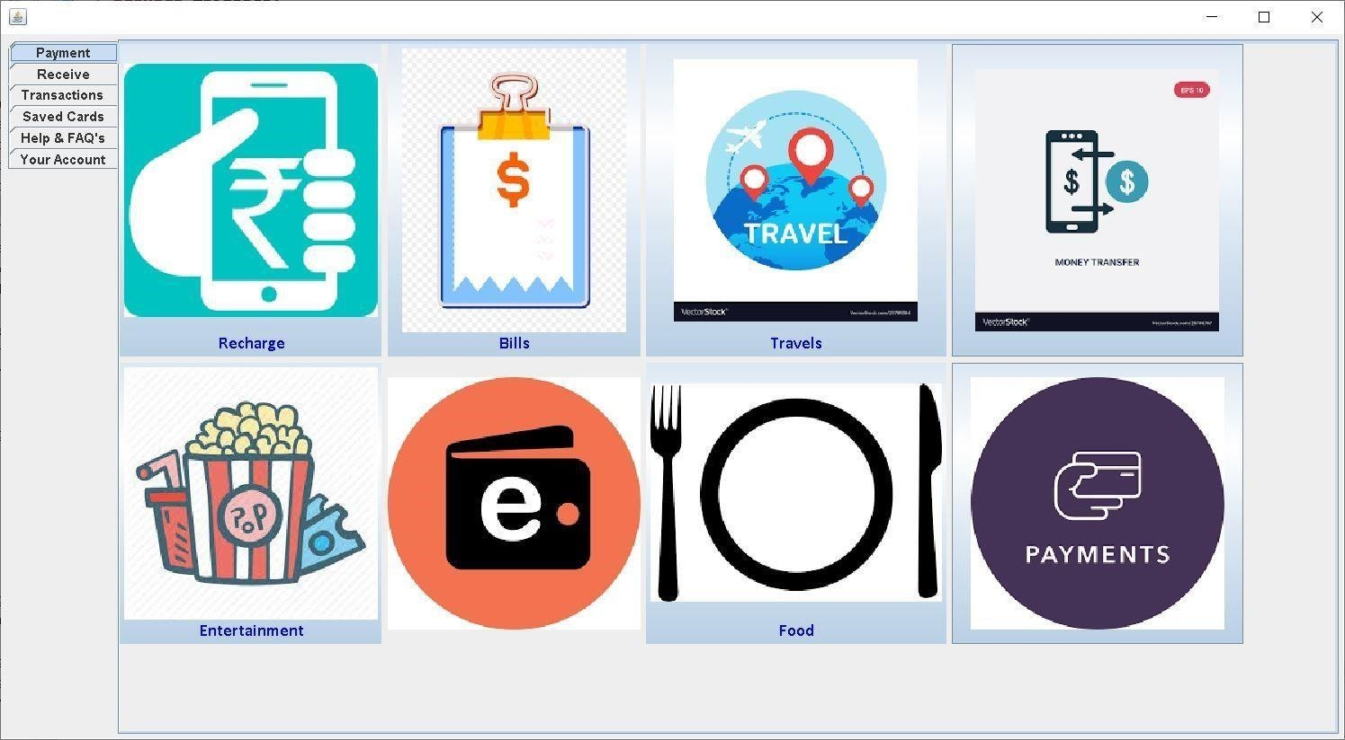
Menu:

Slide 13
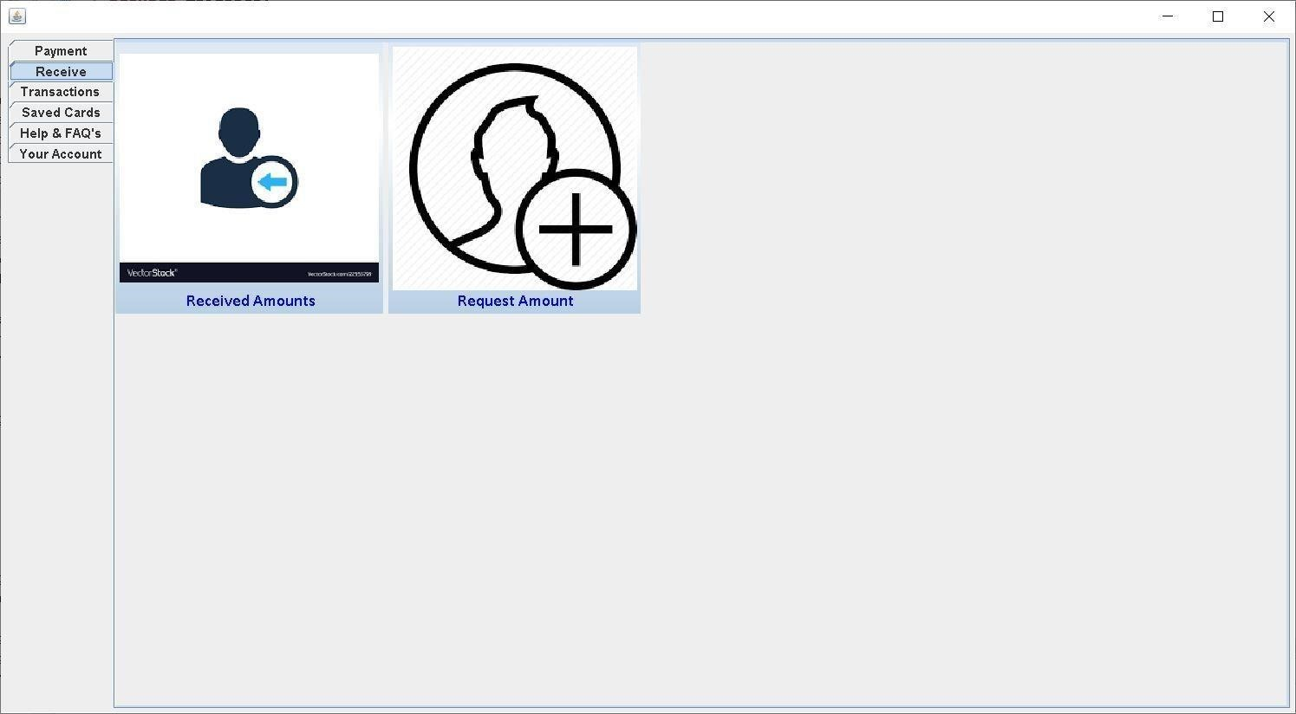
Receive Panel:

Slide 14
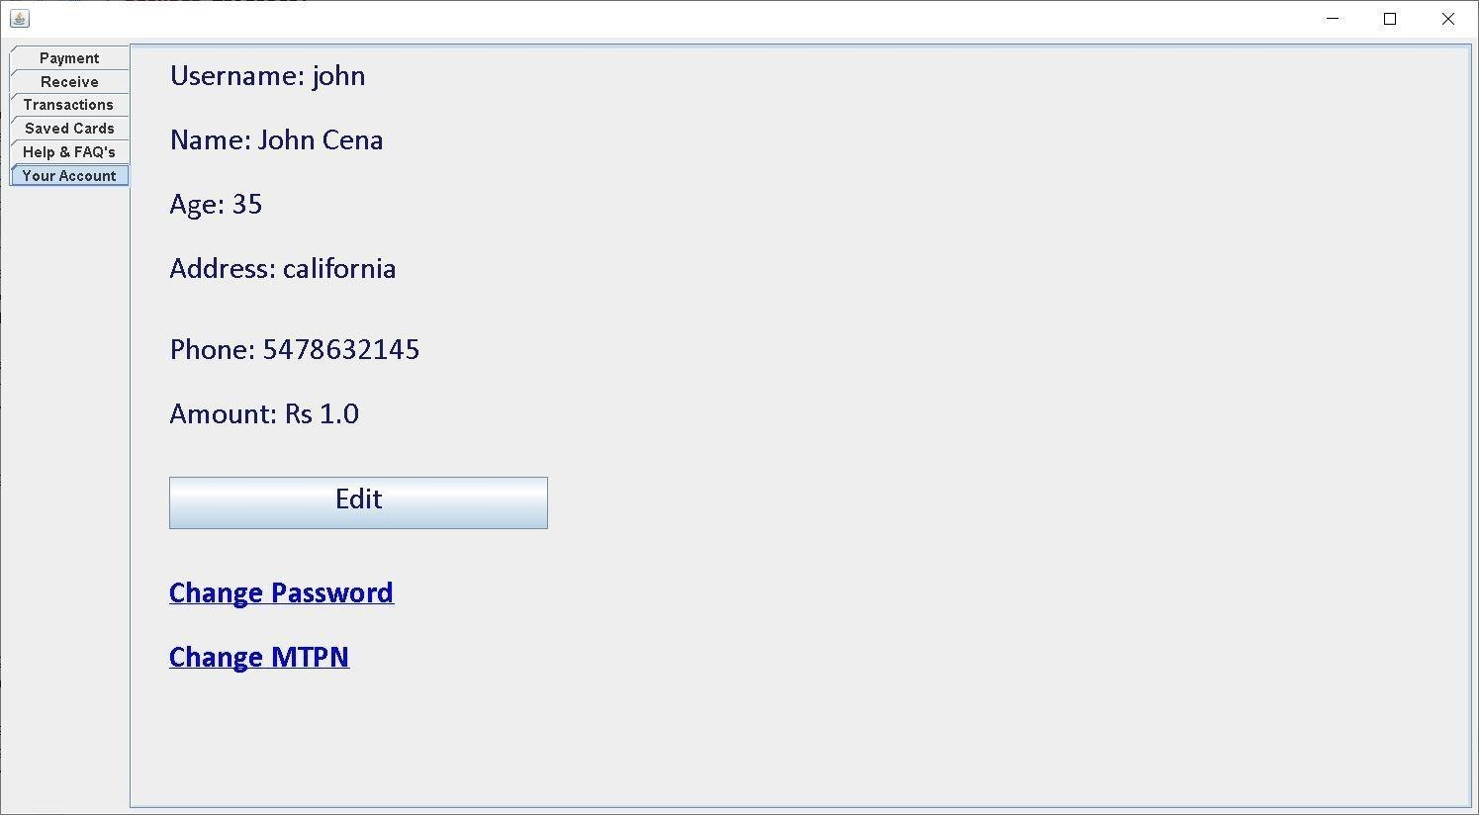
Account Details:

Slide 15
CONCLUSION:
At the end of the project I am able to conclude that
A description of the background and context of the project and its relation to work is already done in the area
Made statement for the aims and objectives of the project
The description about the sources, scope and all of those is describe efficiently
We define the problem on which we are working in the project
We understand the domain that describes the operations being implemented in the program

